Slide 1



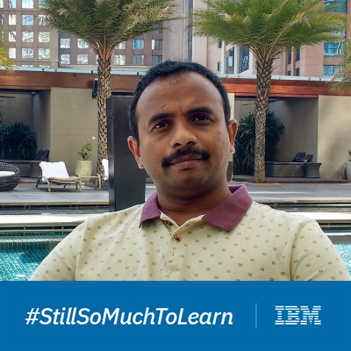

Binary Nova Team
Ananya Stitipragyan
Supriya Sinha
Ravi Nemala
Data Scientist (Developer)
Solution Architect(Developer)
Mentor
Company: IBM Experience: 3+ years Phone Number:+91-9556455437 Email: astitipr@in.ibm.com
Company: IBM Experience: 4.8 years Phone Number:+91-7892859033 Email: supsinha@in.ibm.com
Senior Data Scientist Company: IBM Experience: 20+ years

Slide 2
Wellness Queue
Automation virtualizes the waiting Queue
At medical centers, Labs and hospital

Slide 3


About Existing Procedure
The existing PCR test :
self reporting form
OTP , id, Sample ID as a text message
download ICMR Specimen Referral Form
Wait …. …..

Slide 4


The Problem
Problem statement:
The Medical centers and collection centers do not have the real-time tracking application for queue status while waiting at the quarantined place for their turn to appear.

Slide 5
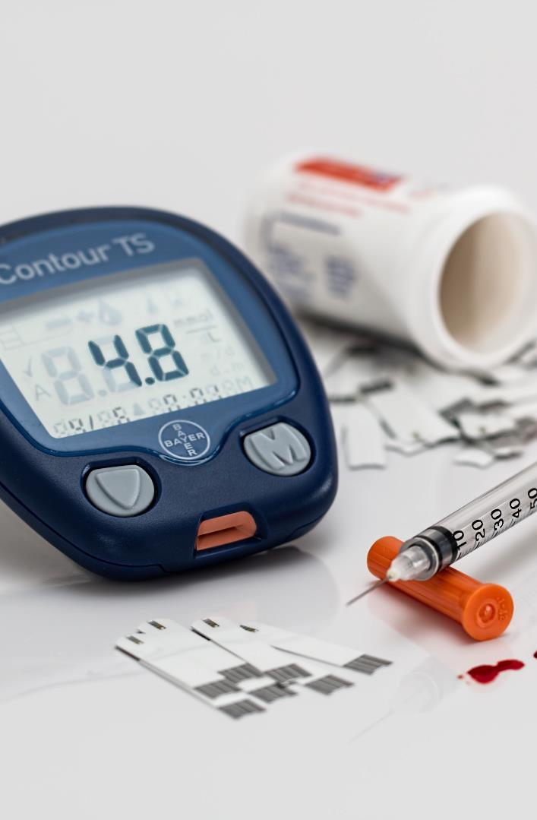











Solution
WellnessQ automates the queue into virtual one. Other category of health department will get facilitated. Help in maintaining safe social distancing.
7
6
4
3
9
Real time tracking of the people in Queue

Slide 6









Queue Tokens
C
L
O
U
D
IBM Cloud Foundry Application
8
Android Native Application
<Rest APIs>
5
JAVA Spring Boot backend
IBM cloud push notification
Google map
FCM
6
MongoDB Atlas
3
Doctor
Patient
Users
Department

Slide 7


Android Native App Demo Video

Slide 8

What is Next?

Slide 9

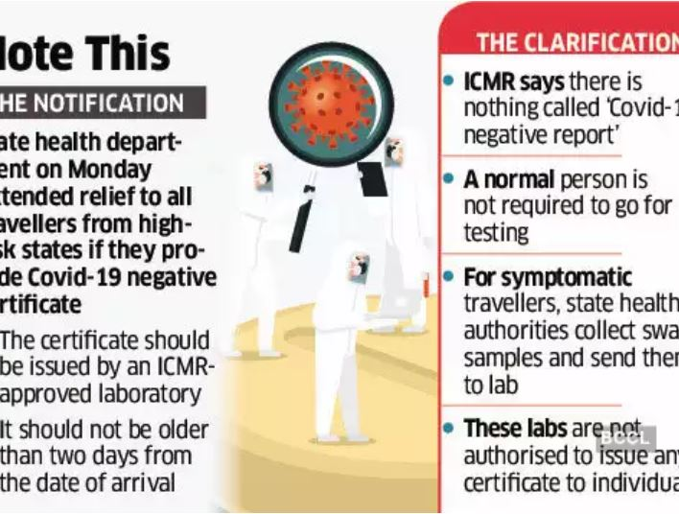
Certificate of confirmation
Extended Feature Of WellnessQ

Slide 10





Future scope
Wait is over?
Patient in Pain should never go through additional stress of waiting and not knowing
* Useful in every industrial sector where the supply of services is limited as per the demand of getting the services
Expected waiting time recommendation
Priority Queue and batch service window
collection of test reports
Issue of certificate of confirmation
WellnessQ Will be useful even after pandemic

Slide 11





Thank You
Team Binary Nova
+91-9556455437
astitipr@in.ibm.com, supsinha@in.ibm.com
Git Link

